Slide 1
MILK JUG BIRD FEEDER
BY KARINA ESPINOZA
Homeroom Class: MS. Miguelez
Science Teacher: Ms. N. Rosales
04/21/2019

Slide 2
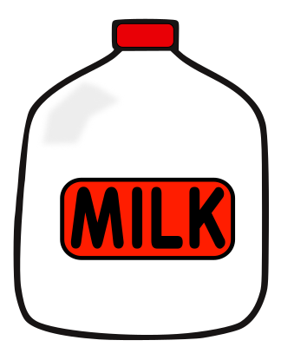
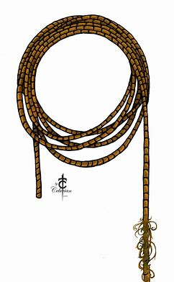
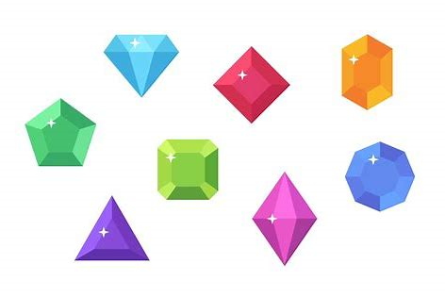
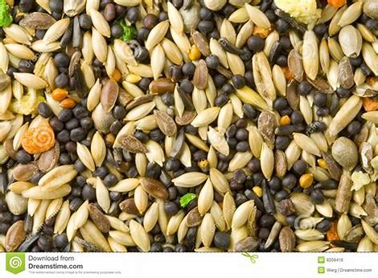
Materials used:
Milk Jug (including the tap)
Ka-bob Sticks
Yard/Thread
Gemstones
Stickers
Bird food

Slide 3
What is the original recyclable material I choose?
Milk Jug
Ka-bob sticks
What is this material originally used for?
The milk jug is used to carry milk.
The Ka-bob sticks is used to sticks meat, seafood, vegetables in to grill .

Slide 4
Describe the after use of your recyclable material
Who ever knew that only ONE milk jug can turn into something that will help the environment, that is CRAZY! One milk jug can be turned into a bird feeder so that bird feeder can be used to feed birds that are looking for food.
The after use of the material is that it is used for feeding endangered birds that need food in the wild, or really that type of bird does not even have to be endangered, after a long time of migration that bird can be hurt so with my bird feeder it has a place to eat.

Slide 5
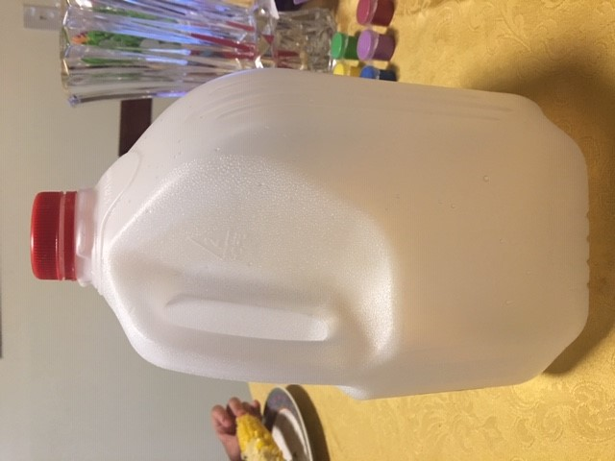
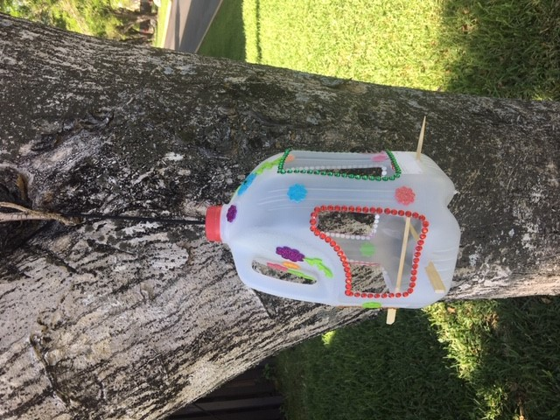
Before and After

