Slide 1
Our class stem projects, mea’s, and field trips!
By: Lucia Ibarra
* Please do not comment while I present I will answer all your questions at the end ☺

Slide 2
What is this about?
In this power point presentation I will briefly explain the STEM in every project and field trip we have done this year I will also be explaining the objective for the every MEA.

Slide 3
Solar eclipse
On the first day of school we watched the solar
eclipse
Science: we saw the moon block the sunlight
Technology: we used special eclipse glasses to be able to see the eclipse take place
Engineering: we made booklets about the eclipse
Math: we needed to know at what time the eclipse would be

Slide 4
The three little pigs
In this project the objective was to make a house that would be strong enough to hold up any strong wind (the wolf)
Science: we needed to find how to block the strong winds
Some teams talked about force fields witch has to do with
Magnetic pull
Technology: we had to look up strong materials on the internet
and decide what materials we wanted to use
Engineering: we had to build our houses and make sure they
were sturdy enough to stand high winds
Math: we needed to find out how much of a material we needed

Slide 5
Parks by the bay
For this MEA we were asked to design a park that would be affordable for the company that we needed to design a playground for
Science: we needed to find out if it was safe if someone fell because of the force of gravity
Technology: we needed to look up the reviews of customers who bought the equipment
Engineering: we needed to actually build the playground
Math: we needed to find out the area and perimeter of each piece of playground equipment

Slide 6
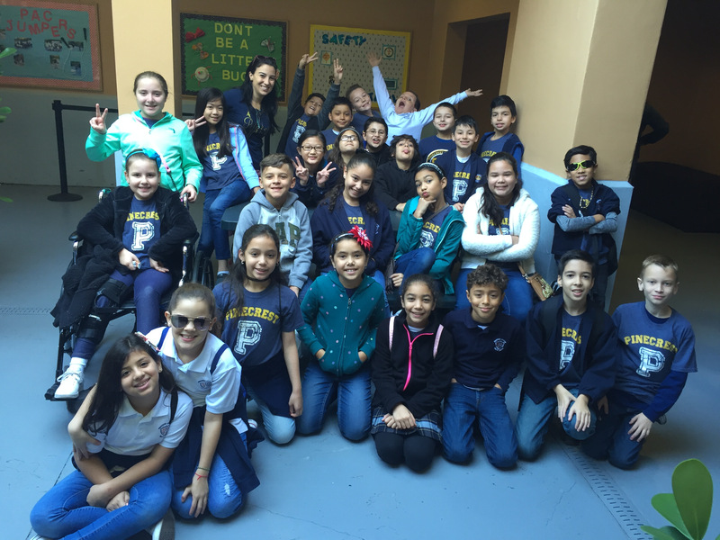
Frost museum
We went to the frost science museum and saw a bunch of interesting things we even entered a planetarium

Slide 7
Santa’s parachute
We needed to design a parachute for Santa and make sure that he would land upright.
Science: we needed to work with gravity and friction
Technology: we looked up the weather
Engineering: we needed to build the parachute
Math: we needed to know how many of each supply we needed

Slide 8
Balloon party planning
In this MEA we had to decide on what balloon company we wanted to hire for our party we needed to make sure it had the qualities that we thought were the most convenient

Slide 9
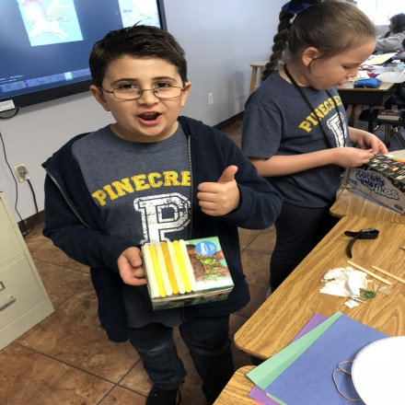
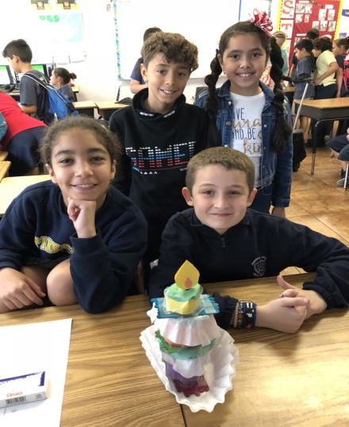
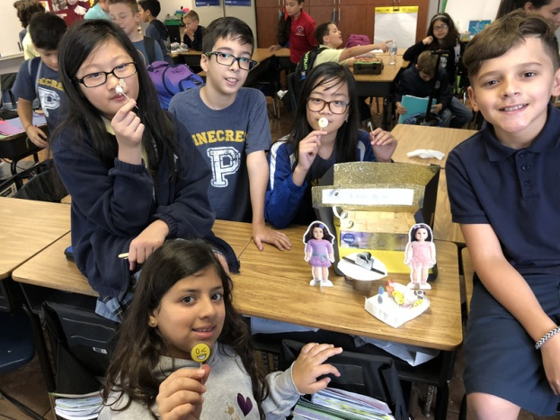
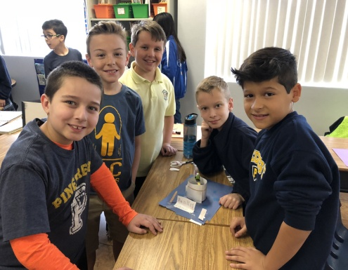
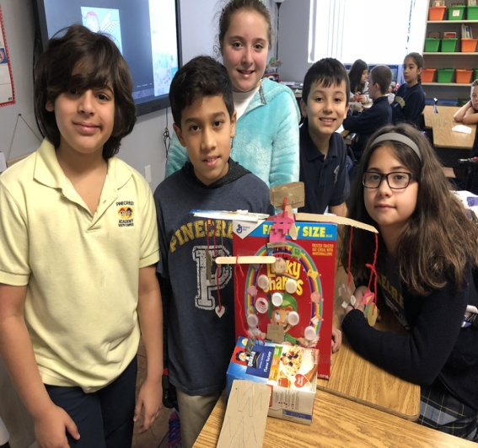
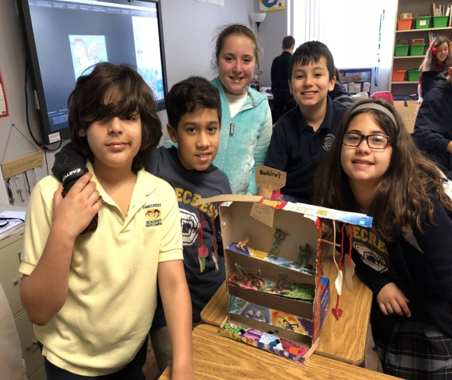
party prototype

Slide 10
cake
Science: chemical changes
take place when cake is
baking
Technology: we needed to
find a cake recipe
Engineering: we needed to
make the cake
Math: we needed to find the
Measurements of each
ingredient

Slide 11
Photo booth
Science: we see
electrical energy when
using the camera
Technology: the camera
Engineering: we had to
Build the photo booth
Math: we needed to
know how many props we
needed

Slide 12
Movie theater
Science: we saw
Electrical energy with
The projector
Technology: we used a
Projector
Engineering: we built
The theater
Math: we needed to find
how many supplies we
needed

Slide 13
Dunk tank
Science: we saw gravity
Pull down the person in
The seat
Technology: we looked
up the weather to see if
The temperature was
Warm
Engineering: we built
The dunk tank
Math: we needed to find the
Perimeter an area of the dunk
tank

Slide 14
Down the man
Science: potential and
Kinetic energy was seen
When the ball was being
Thrown
Technology: we looked
Up pictures for prizes
Engineering: we had to
Build the game
Math we needed to find
Out how many prizes we
needed

Slide 15
Rock climbing
Science: we saw force
When the climber was
Pushing him/herself up
The tower
Technology: we needed
To look up prize ideas
Engineering: we needed
To build the rock
Climbing
Math: we needed to see how
How many bottle caps we
needed

Slide 16
Thank you!!!
Thank you so much for listening questions may be asked at this time

